Slide 1

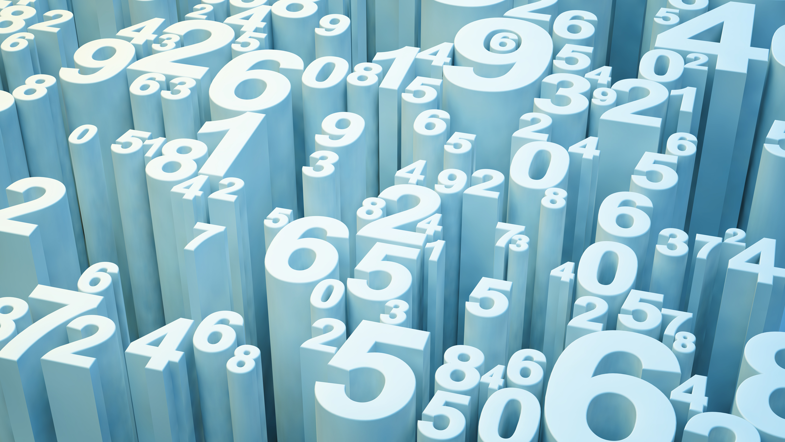
Molar mass and mass to mole relationship

Slide 2
Outline:
Molar mass
Relationship between amount of compounds, molar mass and mass
To complete this presentation you will need access to a periodic table (there is one on the inside cover of your textbook), a calculator and your science notebook.

Slide 3
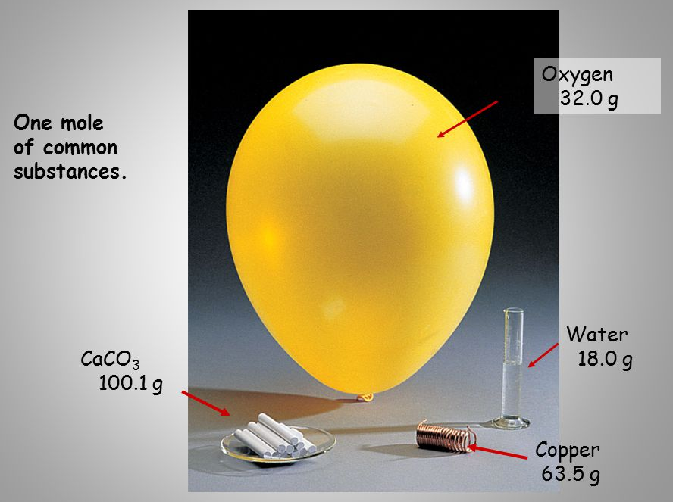
Molar mass
The concept of the mole was defined so that the number of moles of a substance can be determined by simply measuring its mass
Particles of different elements or molecules have different masses therefore, the mass of 1 mole of a substance will also be different

Slide 4
Molar mass
The Molar mass of a substance is defined as the “mass, in grams, of one mole of its particles”
It is given the symbol, M, and the units, g mol⁻¹ (how do we say this? g mol⁻¹ = grams per mole)
1 atom of ¹²C has a relative atomic mass of 12 exactly
1 moles of ¹²C has a mass of 12 grams exactly
*remember naturally occurring carbon contains other isotopes, so the molar mass of carbon is 12.01 g mol⁻¹

Slide 5
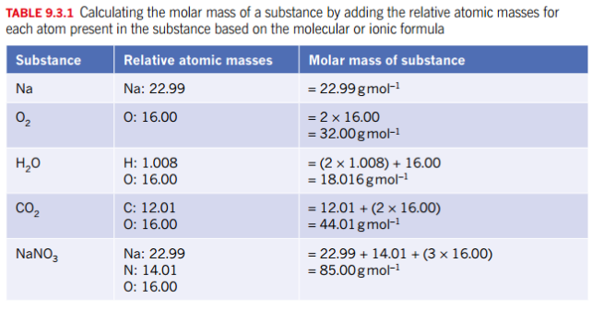
Molar mass
Determining molar mass (do not forget the units)
Ref: Pearsons, Year 11 ATAR Chemistry, WA edition, p 198

Slide 6
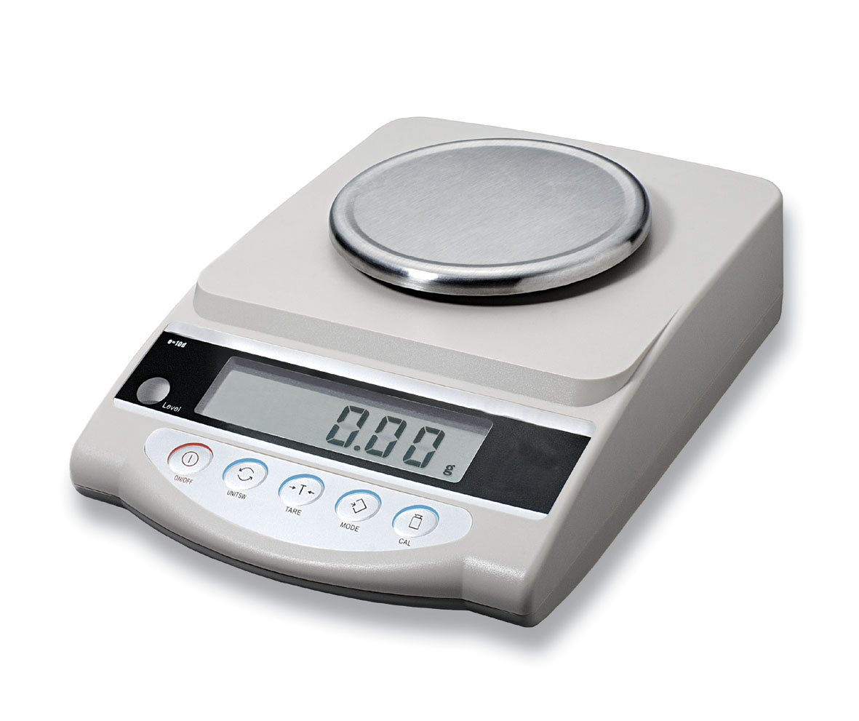
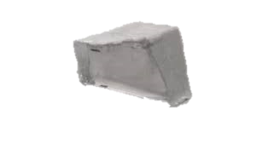



Relationship between moles and mass
There is a useful relationship between the amount of substance (moles) and the weight of the substance (mass)
Knowing the molar mass of a substances allows you to indirectly count its particles by weighing it on a mass balance (scales)
If we weigh out exactly 22.99 g of sodium that is equivalent to counting out 6.02 x 10²³ atoms of sodium (also called 1 mole of sodium)!

Slide 7

Relationship between moles and mass
The relationship can be written as:
mass of substance (g)
$$n= \frac{m}{M}$$
Amount of substance (mol)
Molar mass of substance (g mol⁻¹)
The amount of substance, in mol, equals the mass of substance, in grams, divided by the molar mass of the substance, in grams per mole.

Slide 8
Practice calculation 1
How many moles in 28 grams of carbon dioxide?
What is the mass of 5 moles of Fe₂O₃?

Slide 9
Practice calculation 1
***STOP***
Make sure you have written the answer to the question in your science book before clicking to the next slide.

Slide 10







Practice calculation 1
How many moles in 28 grams of carbon dioxide?
What is the mass of 5 moles of Fe₂O₃?
n(CO₂) = ?
m(CO₂) = 28 g
M(CO₂) = 12.01 + (2 x 16.00)
= 44.01 g mol⁻¹
$$= \frac{28}{44.01}$$
$$n= \frac{m}{M}$$
$$n\left(CO2\right)=0.64 mol$$
Check: 1 mol = 44.01 g so if we have 28 g the answer should be less than 1. makes sense!
n(Fe₂O₃) = 5 mol
m(Fe₂O₃) = ?
M(Fe₂O₃) = (2 x 55.85)+(3 x 16.00)
= 159.70 g mol⁻¹
$$n= \frac{m}{M}$$
$$m=n×M$$
$$m=5×159.70$$
$$m\left(\text{Fe}\text{2}\text{O}\text{3}\right)=798.5 g$$

Slide 11
On-going work
Take notes in your science book on Pearson, ch 9.3
Complete the following practice questions:
Pearson – ch 9.3 review
STAWA – Set 22, 23 (Q1-5), and 24 (Q3,4, 6-10)

